Slide 1

SWAHILI NEWS CLASSIFICATION MODEL.

Slide 2
Project overview
Contracting Party: A news airing company based in East Africa.
Team Involved: Group Six, consisting of five members.
Objective: Increase the company’s sales potential.
Focus Area: Expansion within the news category to be aired.
Task Scope: Enhance content and strategies to boost revenue and audience reach.
Location: East Africa, a region with growing media demand.
Goal: Strengthen the company’s market position through improved sales and influence.

Slide 3
Business understanding
Challenge in Media Reporting: Managing and organizing large volumes of Swahili news
content.
Manual Classification Issues: Time-consuming and prone to inconsistencies.
Need for Automation: Crucial for news platforms, media houses, and content aggregators

Slide 4
Data understanding
Dataset Columns:
id: Unique identifier for each article.
content: Swahili text of the article.
category: News article category (e.g., Uchumi, Kitaifa, Michezo).
Categories:
Uchumi: Business, finance, and economic news.
Kitaifa: General news about Tanzania.
Michezo: Sports-related news.
(Other categories may exist).

Slide 5
Problem statement
News Media Role: Shapes opinion, informs societies, and influences discourse.
Swahili in East Africa: Unifying language for news in Tanzania, Kenya, Uganda,
Rwanda, Burundi, and DRC.
Digital Journalism Growth: Rising Swahili news content needs automated classification.
Project Goal: Use NLP and Deep Learning to categorize Swahili news.

Slide 6
Objectives
● Automating News Classification.
How can we efficiently categorize Swahili news articles using machine learning and deep
learning?
● Understanding Media Trends.
What are the most common news topics in East African media?
Are there any biases in media coverage based on classification trends?
● Enhancing Content Accessibility.
How can automated classification improve information retrieval for journalists, policymakers, and
the general public?

Slide 7
methodology
Rule based methods –POS
Statistical methods-Naïve bayes
ML models-SVM, Random forests
Deep learning models-RNN,BERT
Vector space models-TF-IDF

Slide 8
workflow
univariate
bivariate
multivariate
Modeling andevaluatio
Retraining and eval.

Slide 9
Exploratory data analysis
Univariate
Bivariate
Multivariate

Slide 10
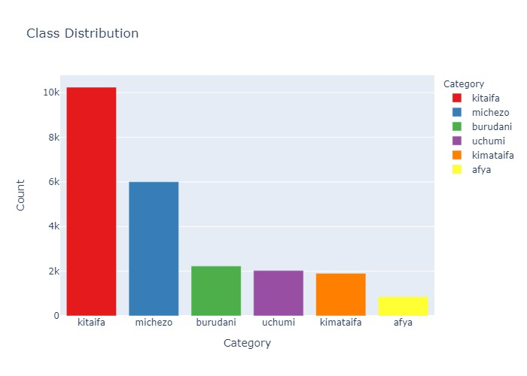
Class distribution for the various categories

Slide 11
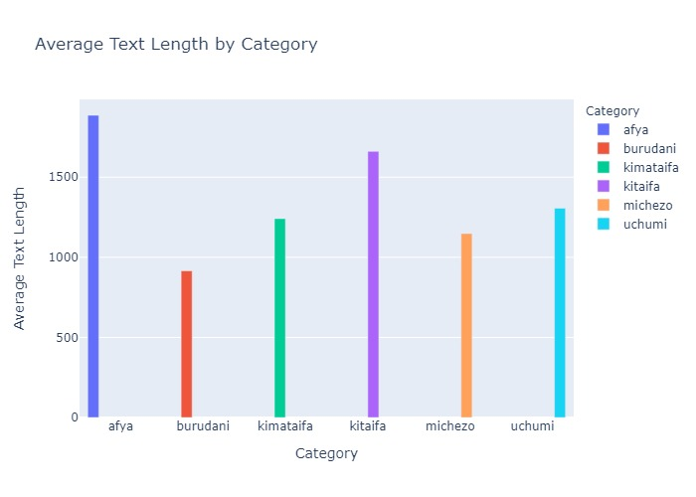
Average text length by category

Slide 12
Modeling report and evaluation (Fine-Tuned BERT-base-uncased for Sequence Classification)
1. High Accuracy (89.41%)
2. High F1 Score (89.34%)
3. The close alignment between accuracy (89.41%) and F1 score (89.34%) indicates that the model is consistent in both positive and negative predictions.
4. The strong validation performance and high F1 score suggest that the model generalizes well to unseen data, not just memorizing the training set.

Slide 13
Conclusion
The "afya" and "kitaifa" categories have the longest average text lengths.
The "afya" category has the highest average word count, indicating longer and possibly more complex content.
Best classifier is Fine-Tuned BERT-base-uncased for Sequence Classification with 89.34% F1 score.

Slide 14
Recommendations
Focus on creating balanced content. Shorter and more concise for categories like "burudani" and more detailed for categories like "afya" and "kitaifa."
Tailor content length based on user preferences to improve retention and interaction.
Automate content tagging and classification to improve searchability and content recommendations using the Fine-Tuned BERT-base-uncased for Sequence Classification

Slide 15
Acknowledgement
Technical mentor: Mr.William Okomba
Team members: group 6 members

Slide 16
Questions
THANK YOU!

